Slide 1

Hitting Your Target
How to Conduct an Employer Focused Job Search
Notes:
The nature of how we conduct a job search has changed. It used to be that our education and our previous jobs all related. So, we would create a chronological resume and let the information speak for itself. Now, given the number of times people change careers…and how often the nature of work changes….we have learn how to CREATE our candidacy and really sell related and transferrable skills.
One of the biggest mistakes we see in our career center is that job seekers create 1 resume that they send out to every employer. We also notice that when job seekers customize their resume, the skills and experience requested by the employer are not clearly and concisely stated on the resume. Many job seekers tell us that they plan on covering this information in the interview….but you may not get an interview if you haven’t created an Employer-Centered resume

Slide 2

The Cart Before the Horse
Before you update your resume, identify the job and employer
Customize your resume to convince the hiring manager you are uniquely qualified for the position.
Trying to be everything to everyone
results in being nothing to everyone.

Slide 3
30 SECONDS
The average time an employer takes to your review your resume.
Notes:
What does this time frame represent? The limited time an employer reviews your resume. So what do you do to get your resume noticed in this short time frame?

Slide 4

Employer-Center Approach
Identifying prospective employers that will want your unique skills and expertise first, then package yourself as a solution to their specific challenges.
The most effective job search campaigns
recognize the employer's needs, reflect
their priorities and focus on solutions
in the form of the candidate's
expertise.
EMPLOYER
Notes:
Your resume should be customized for each employer and each job!

Slide 5

Job Postings
Read job postings very carefully. The job description will describe what the employer is seeking in an ideal candidate.
Reviewing different job postings for similar positions will give you the industry specific vocabulary to include
Follow “how to apply” instructions precisely!
Notes:
Pay attention to the job posting!

Slide 6

Research the Organization & Industry
Occupational research will give you the big-picture information on industry trends, career fields, and the job market
Researching specific employers of interest will bring clarity to the job search process
Where to locate info on an employer’s website:
  About Us
  News
  Company
  Contact Us
  History
  (These headers are typically listed at the
  very top or bottom of the main page)

Slide 7
Resources for Employer & Career Research:
Employer’s website
Type the company name in Google
Occupational Outlook Handbook: http://online.onetcenter.org/
The Career Gateway http://www.gatewaytocareers.com/
America's Career Infonet: http://www.acinet.org/
Bureau of Labor Statistics: http://www.bls.gov/
CareerProject: http://thecareerproject.org/Home
RileyGuide: http://www.rileyguide.com/

Slide 8

How To Customize Your Job Search
Gather Information
Review Industry/Career Info
Review Job Description
Review Company Website
Resume Customization:
Summary of Skills/Profile
Functional Skills Headings
Customized 2-minute Presentation
Customized Interview Questions For the Employer
Notes:
In your packet, you have a document titled “Combination Resume Sample”. This resume is utilized when your work history is closely related to your current career objective. This resume includes a summary of skills section. This section should be customized as a direct response to the employer’s stated objectives listed on the job description. You will notice it is located at the very top of the resume so that if the employer stops reading the document ½ way through, they have obtained all of the relevant information for determining if they should consider your candidacy. We will look at two examples to illustrate how to do this.
In your packet you have an example of a resume titled “Example Function Resume” in which the job seeker has utilized a profile section and has organized the resume in a functional style. Profile sections are typically used when utilizing a functional resume. The functional resume is an opportunity to put the emphasis on your related skills and not necessarily your job history. We will also look at two examples to illustrate how to develop skill subheadings specific to the position and industry.
2-minute presentation is your brief introduction to an employer in which you clearly state:
Your skills and experience as it relates to the employer’s stated objectives
Why you are interested in this particular position and employer
Your expected to ask thoughtful questions of the employer. You should prepare questions ahead of time for this, type them up and bring them in a padfolio. This will occupy about 10 minutes of the interviews.

Slide 9

Example 1:
*The Learning House, Inc. Relationship Manager
*Selected as a “Fast 50” for company growth in Business First: The Book of Lists published December 23, 2011
Notes:
Let’s apply these recommendations with actual job postings. Our first example is The Learning House Inc. Relationship Manager position.

Slide 10

Review Job Posting
Refer to Example Job Posting #1: Learning House Inc. in your Build Skills packet

Slide 11
Overview
We are currently looking for an account executive professional that enjoys developing and maintaining relationships with current customers and helping them grow. If you are looking for an opportunity to work with a fast-growing dynamic company that provides accelerated professional opportunities in the thriving online education industry, we would love to hear from you.
Job Skills/Requirements
In this role, you will promote and generate the use of online educational content and services to institutions of higher learning all over the nation, from an office environment as well as on the road, while providing superior customer service. Other responsibilities of this position include, but are not limited to:
Coordinate and conduct personal and online meetings to facilitate the implementation of recommendations and best practices.
Liaise with the partner and internal marketing teams to plan and implement marketing and lead-generation objectives.
Provide support to the publishing and marketing departments to facilitate implementation of objectives.
Maintain strong relationships with partners and help them identify additional growth opportunities.
Lead a partner-focused internal team of professionals whose members report to other departments.
Notes:
Each time you apply to a position, before you customize your resume, you should highlight the content that you intend to provide a response to in your resume. So, let’s look at this first example in your packet. What are the key points that the employer has stated that you need to provide a response to on your resume?

Slide 12
Overview
We are currently looking for an account executive professional that enjoys developing and maintaining relationships with current customers and helping them grow. If you are looking for an opportunity to work with a fast-growing dynamic company that provides accelerated professional opportunities in the thriving online education industry, we would love to hear from you.
Job Skills/Requirements
In this role, you will promote and generate the use of online educational content and services to institutions of higher learning all over the nation, from an office environment as well as on the road, while providing superior customer service. Other responsibilities of this position include, but are not limited to:
Communicate directly with partner institutions to deepen the relationships while increasing partner presence and offerings of online programs and classes.
Coordinate and conduct personal and online meetings to facilitate the implementation of recommendations and best practices.
Liaise with the partner and internal marketing teams to plan and implement marketing and lead-generation objectives.
Provide support to the publishing and marketing departments to facilitate implementation of objectives.
Maintain strong relationships with partners and help them identify additional growth opportunities.
Lead a partner-focused internal team of professionals whose members report to other departments.

Slide 13
The successful candidate who fills this role will have the following skills/experience:
Minimum education of Bachelors Degree plus 2-5 years experience; though an advanced degree is preferred
Experience in a position that deals directly with customers (front-line)
Previous sales, marketing and/or relationship management experience
Must be able to effectively communicate and follow-up equally with co-workers and customers
Must be able to learn and retain vast amounts of client information
Experience in a team-based environment is preferred
Experience in higher education is a bonus
Experience using Client Resource Management (CRM) software is preferred

Slide 14
The successful candidate who fills this role will have the following skills/experience:
Minimum education of Bachelors Degree plus 2-5 years experience; though an advanced degree is preferred
Experience in a position that deals directly with customers (front-line)
Previous sales, marketing and/or relationship management experience
Must be able to effectively communicate and follow-up equally with co-workers and customers
Must be able to learn and retain vast amounts of client information
Experience in a team-based environment is preferred
Experience in higher education is a bonus
Experience using Client Resource Management (CRM) software is preferred

Slide 15

Review Company Website
Refer to Example #1 Website Content: Learning House Inc. in your Build Skills packet
Notes:
Remember, prior to applying to a position, you should have already conducted your industry and career research for general information and key words. Now it’s time to focus on the specific employer. Before customizing your resume and interviewing, you should take some time to review the company website.

Slide 16
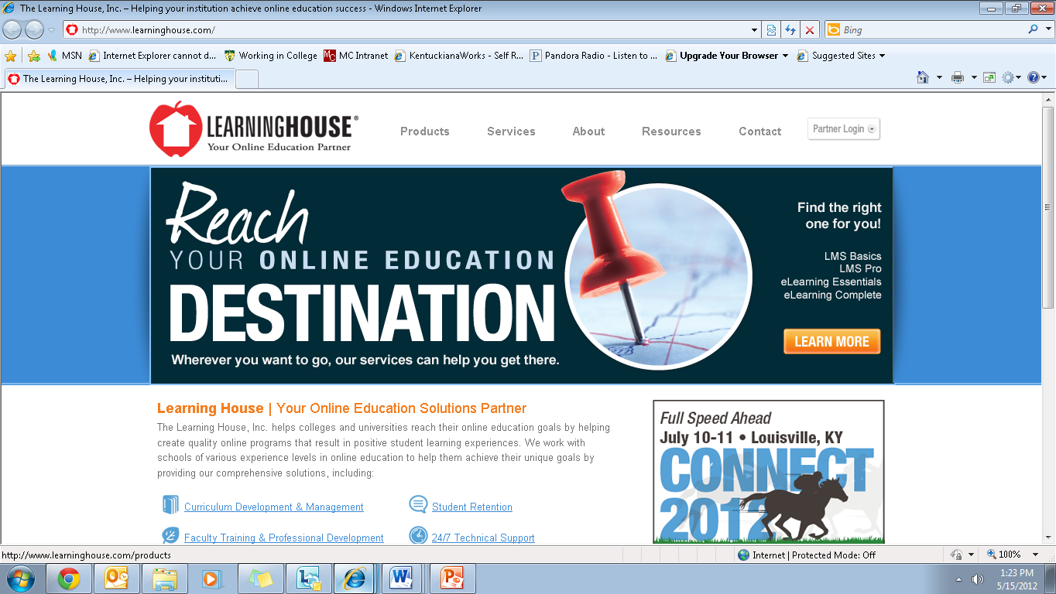
Notes:
I have copied some content from Learning Houses’ website. Refer to your packet to the page titled “Example #1 Website Content: Learning House Inc.” What does the employer state here that you should include in your customization of your resume or interview?
Company focuses on growing high-quality on-line degree programs and courses.
It’s mission:
help students learn by offering flexible on-line degree programs so they can positively change their lives and their community
Help colleges adopt new technologies to offer high quality education for those who need flexibility in gaining an education
Looking to accelerate the growth of the company by enhancing the customer experience, operational excellent, marketing expertise and strategic and disciplined management.

Slide 17

Packaging Yourself As a Solution
SKILLS
EXPERIENCE
Notes:
Now that you have identified the desired skills and experiences for this particular position. And you clearly understand the mission of the organization….It is time to utilize this information to create an employer-centered resume.

Slide 18
Customized Summary of Skills or Profile
Adept at interpersonal relations with over 5 years direct customer service experience.
Proven record of sales and marketing of Fortune 500 company products generating $5 million in annual revenue.
Demonstrates proficiencies in Client Resource Management software, Microsoft Office Suite, web conferencing and on-line meeting tools, and working knowledge of e-learning development and software.
Proven leader with experience in supervision in a higher education setting.
Exhibit thorough project management skills through organization of project components from development to successful implementation.
Effectively collaborates in team-based environment to plan and implement marketing and lead generation objectives.
Able to identify success factors for each client interaction and consider expectations that may provide additional growth opportunities.
Focused on growing customer relationships through establishing trust, utilizing tools for building credibility and maintaining high standards.
Notes:
Here are some example summary of skills statements that summarize the candidates qualifications. The skills and experience statements focus on the employer’s identified needs for the ideal candidate.
Remember refer to “Combination Resume Sample” to see where these key statements are located on a resume. The red lines indicate language that is a direct match to those skills and requirements listed in the job description. If I were an employer with just 30 seconds to review this resume, I have obtained the information I need to determine if you are a viable candidate. I didn’t have to go searching through the resume to see if you were a match.
These statements could also be used as a profile section.

Slide 19

Resume Headings
Functional Skills Subheadings
  Customer Relationship Management
  Marketing and Sales
  Curriculum Development
  Post-Secondary Education
  Experience
  Information Technology
  Management/Leadership
  Communication
  Project Development
Other Section Headings
  Accomplishments
  Professional Development
  Profile
Employer
Focus
Notes:
One of the mistakes job seekers make with functional resumes is they keep the same skill subheadings without taking into consideration the employer’s desires and goals. Remember, a functional resume is utilized when a job seeker wants to emphasize RELATED skills…not the job history.
Refer to the “example functional resume” in your packet. In the middle of the page you will see a header “Related Skills and Experience”. Below this, you will see subheadings. These subheadings should highlight your understanding of what the employer is asking for in their ideal candidate. Also, by giving thought and organization to this section, you will ensure that you are only listing information relevant to the employer rather than giving a biographical history that may or may not be related to the employer’s needs.
Here are a few examples of functional skill headings for the Learning House position….
Some other section headings you may want to include are…
- Accomplishments--- this is an excellent way to clearly highlight your achievements as it relates to sales goals, revenue, cost savings, etc.
Professional Development- highlight presentation and associations related to the industry and employer’s interests
Profile – similar to the summary of skills section – concise statements that provide a direct response to the needs stated in the job description

Slide 20
How To Customize the Interview
2-Minute Presentation
  Background in higher education
  E-learning project completed that highlights the skills and assets bringing to the company
  Sales and relationship management example
  Personal experience with e-learning in own education
  Customer service success story
  Acknowledge how organization’s mission fits with your experience and interests
Questions for the Employer
  Is there a sales goal for new accounts?
  What kind of assessments does Learning House conduct to determine the impact of their products?
  Are you investigating additional methods for online learning including mobile learning?
Notes:
Here are some examples of topics you could cover in your two minute presentation. Remember, a 2-minute presentation is a summary of your candidacy that highlights your relevant skills and experiences and why you are interested in this particular employer and position.
An example of what you could state “I took several on-line classes as an undergraduate student so I learned first-hand how the flexibility of online degree programs can positively impact lives.”– this statement is a direct tie to the company’s mission statement listed on their website.
The employer stated that growth and adopting new technologies is central to their mission, the questions listed here reflect those goals.

Slide 21

Example 2:
*ZirMed, Inc. ACCOUNT EXECUTIVE (SALES)
*Selected as a “Fast 50” for company growth in Business First: The Book of Lists published December 23, 2011
Notes:
Ok…let’s look at another job posting example to practice employer centered job search practices.

Slide 22
Review Job Posting
Refer to Example Job Posting #2: ZirMed in your Build Skills packet

Slide 23
Overview
The Account Executive position will be responsible for making several contacts daily with prospects in defined territories, acquiring new customers, maintaining strategic account relationships and driving profitable revenue growth. This position will work closely with the VP of Sales to implement strategic marketing and sales execution plans in order to achieve business objectives.
Job Functions
• Generate leads, prospect potential customers and close new accounts
• Prepare action plans and schedules to achieve specific targets in an activity sales model
• Follow-up on new leads and referrals resulting from marketing activities
• Prepare presentations, proposals and sales contracts
• Build and manage relationships at all appropriate levels of accounts
• Communicate new product, service, initiative and relevant information to new accounts
• Manage and oversee multiple daily sales tasks
• Establish territory strategy to improve market penetration
• Prepare a variety of status reports, including activity, closings, follow-up and adherence to goals
• Keep abreast of competitor's strengths and weaknesses
Notes:
Based on what the employer has written in this job description, what do you need to specifically address in your resume and in the interview?
Again, this is where you would get our your highlighter and highlight the main points.

Slide 24
Overview
The Account Executive position will be responsible for making several contacts daily with prospects in defined territories, acquiring new customers, maintaining strategic account relationships and driving profitable revenue growth. This position will work closely with the VP of Sales to implement strategic marketing and sales execution plans in order to achieve business objectives.
Job Functions
• Generate leads, prospect potential customers and close new accounts
• Prepare action plans and schedules to achieve specific targets in an activity sales model
• Follow-up on new leads and referrals resulting from marketing activities
• Prepare presentations, proposals and sales contracts
• Build and manage relationships at all appropriate levels of accounts
• Communicate new product, service, initiative and relevant information to new accounts
• Manage and oversee multiple daily sales tasks
• Establish territory strategy to improve market penetration
• Prepare a variety of status reports, including activity, closings, follow-up and adherence to goals
• Keep abreast of competitor's strengths and weaknesses

Slide 25
KNOWLEDGE AND SKILLS REQUIRED:
• Minimum 2 years sales hunting experience
• Proven sales performance and ability to close new accounts
• Strong customer relationship experience
• Proven track record of delivering results
• Experience working in high growth environments
• Outgoing and a self-starter with strong organizational skills
• Excellent verbal and written communication skills
• Healthcare background and/or industry experience beneficial
• Excellent with e mail, Microsoft Word, Excel and PowerPoint
• Ability to maintain a professional appearance and present a positive company image
• Experience working with Salesforce.com a plus
Education Requirements
- Bachelor's Degree, Graduate Degree or MBA preferred
Notes:
Again, what is important in this list of requirements?

Slide 26
KNOWLEDGE AND SKILLS REQUIRED:
• Minimum 2 years sales hunting experience
• Proven sales performance and ability to close new accounts
• Strong customer relationship experience
• Proven track record of delivering results
• Experience working in high growth environments
• Outgoing and a self-starter with strong organizational skills
• Excellent verbal and written communication skills
• Healthcare background and/or industry experience beneficial
• Excellent with e-mail, Microsoft Word, Excel and PowerPoint
• Ability to maintain a professional appearance and present a positive Company image
• Experience working with Salesforce.com a plus
Education Requirements
- Bachelor's Degree, Graduate Degree or MBA preferred

Slide 27
Review Company Website
Refer to Example #2 Website Content: ZirMed in your Build Skills packet

Slide 28
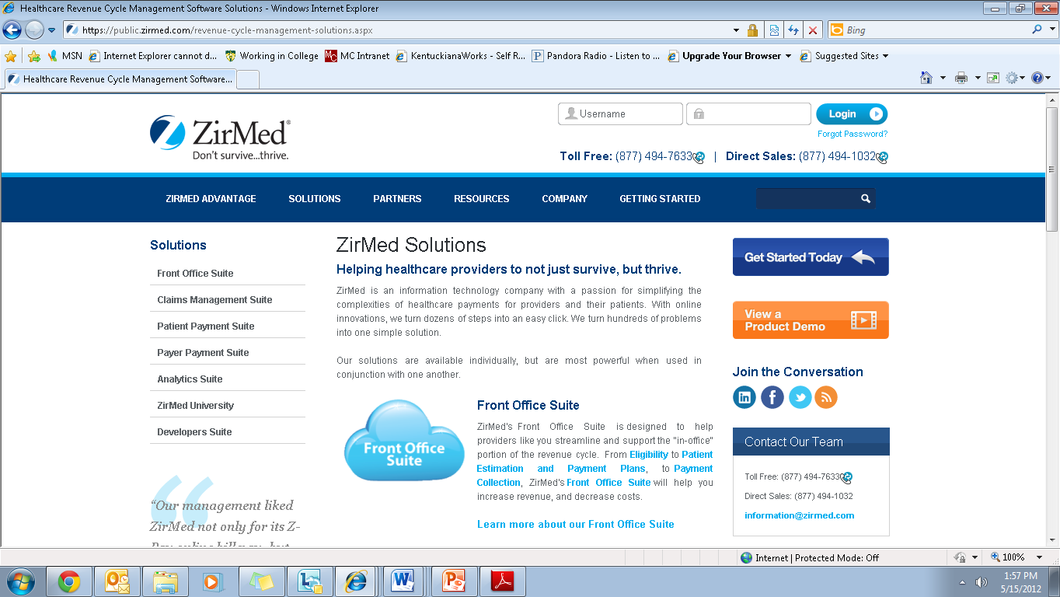
Notes:
I have copied some content from ZirMed’s website. Refer to your packet to the page titled “Example #2 Website Content: ZirMed.” What does the employer state here that you should include in your customization of your resume or interview?
The employer clearly stated their vision and mission…
To revolutionize the business of healthcare and cure administrative costs by applying innovative, creative and flexible technology solutions.
To reduce inefficiencies and increase productivity and revenues for healthcare providers through proactive revenue cycle management solutions and support…..etc.
Employer website include a great deal of information. Make sure you do not ask questions during the interview that could have been answered by simply reviewing the employer’s website.

Slide 29
Packaging Yourself As a Solution
SKILLS
EXPERIENCE
Notes:
Now that you have identified the desired skills and experiences for this particular position. And you clearly understand the mission of the organization….It is time to utilize this information to create an employer-centered resume.

Slide 30
Customized Summary of Skills or Profile
7 years successful experience in direct sales and new account development in healthcare.
Promotes high standards of professionalism, integrity and leadership.
Self-motivated, flexible results-driven individual who can work with minimal supervision in high growth environments.
Excellent negotiation skills with the ability to leverage knowledge of competing companies to generate new leads and retain customer base.
Innovative, self-starter with a proven record of generating customer leads, obtaining new accounts and securing repeat commitments.
Demonstrated ability to identify and develop strategic marketing goals and consistently surpass sales quotas.
Proficient in Microsoft Word, Excel, PowerPoint, and Outlook with working knowledge of Salesforce.com.
Communicate effectively through all avenues including online and onsite presentations, social media, and sales reports.
Notes:
Here are some example summary of skill statements that provide a direct response to the job posting
When you upload your resume to an on-line job posting service and apply to a position, many use computer software to identify the matches in the candidates resume statements to the stated objectives in the job posting. The computer will pull the resume with the highest relevance.

Slide 31

Resume Headings
Functional Skills Subheadings
  Customer Relationship Management
  Strategic Marketing and Sales
  Management/Leadership
  Communication
  Healthcare Industry Experience
  Needs Assessment
Other Section Headings
  Accomplishments
  Profile (if utilizing functional format and has experience)
Target
Your
Skills
Notes:
Again, you will need to customize your functional skill subheadings to ensure your content speaks to the employer’s needs.

Slide 32
How To Customize the Interview
2-Minute Presentation
  Sales experience and accomplishments
  Sales strategy
  Customer satisfaction
  Healthcare background with example of client related goals met
  Mentoring, training, and managing other sales
  representatives
  Provide examples of how past experience will allow
  company to meet goals and expand (refer to mission)
  State how your innovation and creativity resulted in
  achieving and exceeding sales and marketing goals.
Questions for the Employer
  What is the profile of your top performer?
  What are the characteristics and common needs of your client base?
  How does your company culture support the company vision and mission statement?
  You are one of the top 50 growing companies in Louisville, to what do you contribute your success and what are your goals moving forward?
Notes:
Again, tie your two minute back into your research. For example, state how your past experience will allow you to support their mission of applying innovative, creative and flexible technology solutions to reduce inefficiencies and increase productivity and revenues for healthcare providers.
Reflect your research by stating you know they were recognized as a top 50 growing company of Louisville.

Slide 33

Questions

